Slide 1
Algorithm Analysis
Il-Chul Moon Dept. of Industrial and Systems Engineering KAIST
icmoon@kaist.ac.kr

Slide 2
Weekly Objectives
This week, we learn how to analyze the efficiency of our program
Algorithm analysis
Objectives are
Memorizing the definition and the rules of the big-Oh notation
Understanding what determines the efficiency of programs
Understanding simple algorithms
Memorizing the insert and the delete of lists, stacks, and queues
Memorizing the bubble sort
Able to apply the big-Oh notation analysis to programs

Slide 3


Factors of program’s efficiency
Algorithm
A clearly specified set of simple instructions to be followed to solve a problem
Takes a set of values as inputs
Produces a set of values as outputs
Specified in
English
A computer program
Pseudo-code
Data structures
Methods of organizing data
Program
= algorithms + data structures
N iterations with Array List
Insertion Algorithm
logN iterations with BST

Slide 4
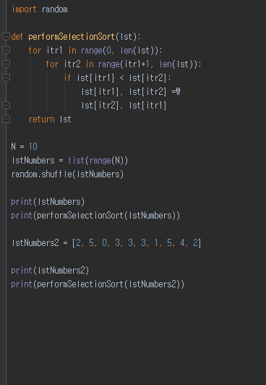

Bubble sort algorithm
Examples of algorithms
Insertion, deletion, search of linked lists, stacks, queues…
Sorting of linked lists…
Various sorting methods
Bubble sort, Quick sort, Merge sort…
Bubble Sort(list)
For itr1=0 to length(list)
For itr2=itr+1 to length(list)
If list[itr1] < list[itr2]
Swap list[itr1], list[itr2]
Return list
This program uses
Data structure: List
Algorithm: Bubble sort

Slide 5
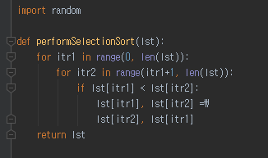

Example of bubble sort execution
Let’s observe the execution of the bubble sort
Total iterations
= 9+8+….+1
=45 iterations
=$\frac{n(n−1)}{2}$=$\frac{1}{2}n^{2}−\frac{1}{2}n$
[2, 5, 0, 3, 3, 3, 1, 5, 4, 2]
(itr1 = 0, itr2=1..9) = 9 iterations
(itr1 = 0, itr2 = 1)
2 < 5, Hit and swap!!!
list[0] = 5, list[1] = 2 from now
(itr1 = 0, itr2 = 2)
5<0, No hit
(itr1 = 0, itr2 = 3)
5<3, No hit
…..
(itr1 = 1, itr2=2..9) = 8 iterations
….
….
(itr1 = 8, itr2=9..9) = 1 iterations
…..

Slide 6
Why do we care about efficiency?
Writing a working program is not good enough
The program could be inefficient
If the program runs on a large data, the running time becomes a big issue
Sometimes, a program may not be usable because of the efficiency
Imagine a transaction system of a financial company
1 transaction = 0.001 sec
10 transactions by 10,000 account holders = 100 sec
Side effect → If there is no reaction from the system, the users click the request again! → Increased requests when there is a delay
Imagine a bubble sorting function for bank accounts
10,000 accounts → roughly 50,000,000 iterations for sorting
Therefore, we need a guarantee of the worst-case scenario
The worst-case running time of a single transaction
The worst-case transaction request numbers of a single day

Slide 7
Definition of Algorithm Analysis
Analyzing an algorithm
Estimating the resources that the algorithm requires
Memory
Communication bandwidth
Computational time (the most important resource in the most of cases)
Factors affecting the running time
Computer used for executions
Algorithms
Data structures
Input data size
After analyzing the algorithms
We estimate the worst-case of the costs by the factors
i.e. Computational time by input data size
i.e. Iterations by input data size

Slide 8
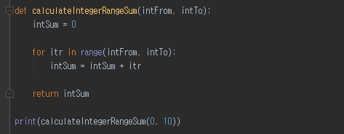
Simple algorithm analysis
1
2
3
4
Line 1 to 4
Line 1 : 1 iteration
Line 2, 3: (intTo-intFrom) iterations X 2 lines= N iterations X 2lines = 2N iterations
Line 4: 1 iteration
Total # of iterations = 2N+2 iterations=O(N)

Slide 9
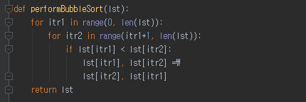
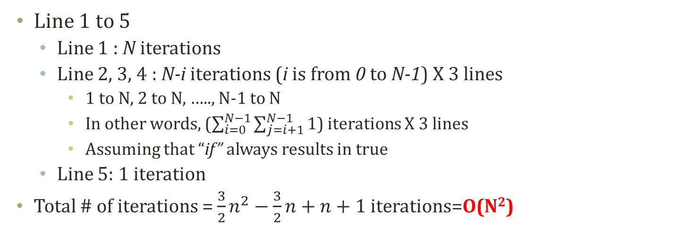
Bubble sort algorithm analysis
1
2
3
4
5
Line 1 to 5
Line 1 : N iterations
Line 2, 3, 4 : N-i iterations (i is from 0 to N-1) X 3 lines
1 to N, 2 to N, ….., N-1 to N
In other words, ($\sum_{i=0}^{N−1}{\sum_{j=i+1}^{N−1}{1}}$) iterations X 3 lines
Assuming that “if” always results in true
Line 5: 1 iteration
Total # of iterations = $\frac{3}{2}n^{2}−\frac{3}{2}n+n+1$ iterations=O(N²)

Slide 10
Asymptotic notation: Big-Oh
What do O(N) and O(N²) mean?
That’s the Big-Oh notation
Notation to show the worst-case running time
Do you remember?
Assuming that “if” always results in true
So, this is a worst scenario for the run-time
Because the program should run the statements in the “if” block
Definition of the Big-Oh notations
f(N) = O(g(N))
There are positive constants c and n₀ such that
f(N) ≦ c g(N) when N ≧ n₀
The growth rate of f(N) is less than or equal to the growth rate of g(N)
g(N) is an upper bound on f(N)

Slide 11
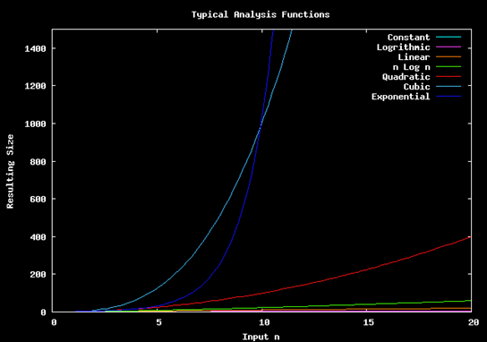
Growth rate
Exponential function (c^{n}) grows more than cubic function (n³)
Definition of the Big-Oh notations
f(N) = O(g(N))
There are positive constants c and n₀ such that
f(N) ≦ c g(N) when N ≧ n₀
The growth rate of f(N) is less than or equal to the growth rate of g(N)
g(N) is an upper bound on f(N)
Quadratic function (n²) grows more than linear function (n)

Slide 12
Examples of Big-Oh notation
Assume f(N) = 7N². Then
f(N) = O(N⁴)
f(N) = O(N³)
f(N) = O(N²) (best answer, asymptotically tight)
N² / 2 – 3N
O(N²)
1 + 4N
O(N)
7N² + 10N + 3
O(N²)
log₁₀ N = log₂ N / log₂ 10
O(log₂ N) = O(log N)
sin N
O(1)
10
O(1)
10¹⁰
O(1)
log N + N
O(N)

Slide 13
Rules of Big-Oh notation
When considering the growth rate of a function using Big-Oh
Ignore the lower order terms and the coefficients of the highest-order term
When we have N³, then N² and N means nothing in terms of Big-Oh
From the growth rate order
c^{N} > N^{k} > N² > NlogN > N > logN > C
C >= 2 and k > 2
No need to specify the base of logarithm
O(logN) = O(log_{C}N)
If T₁(N) = O(f(N)) and T₂(N) = O(g(N)), then
T₁(N) + T₂(N) = max(O(f(N)), O(g(N)))
max(O(N), O(N²)) = O(N²)
T₁(N) * T₂(N) = O(f(N) * g(N))
O(N) * O(logN) = O(NlogN)

Slide 14
Big-Oh notation of list, stack and queue
 | List | Stack | Queue
Pop | X | 1 retrieval O(1) | X
Push | X | 1 retrieval O(1) | X
Enqueue | X | X | 1 retrieval O(1)
Dequeue | X | X | 1 retrieval O(1)
Search | i retrieval (if the target instance at i^{th} in the list) O(N) | X (Does not allow search in the stack) | X (Does not allow search in the queue)

Slide 15
Detour: Performance of binary search tree
3
Coming from divide and conquer
 | Linked List | BST in Average | BST in Worst Case
Search | O(n) | O(log n) | O(n)
Insert after search | O(1) | O(1) | O(1)
Delete after search | O(1) | O(1) | O(1)
Traverse | O(n) | O(n) | O(n)
2
5
0
4
7
BST in Average
Insert 3, 2, 0, 5, 4, 7
0
2
3
4
BST in Worst Case
5
Insert 0, 2, 3, 4, 5, 7
7

Slide 16
Further Readings
Introductions to Algorithms by Cormen et al.
pp. 5-61

